Slide 1
First Meetup Event - SSM Chapter
I personally welcome everyone to this meetup!
Lets wait till everyone turns up!

Slide 2
About the meetup!
The meetup series was brought about to involve coding into interesting projects, not as a boring tutorial sessions we attend everyday.
But since this is the first meetup, I thought we can get to know each other and decide what topics we can bring on this meetup series.

Slide 3
Is it too confusing what we are doing?
SSM Chapter
>Code learning
>Project Brainstorming
>Study groups
Code learning
Project Brainstorming
Study groups
…it’s hot
…it’s big
…it’s cold

Slide 4
Agenda
1
2
3
4
Lets know you!
Just Me
A little about me!
Who are you?
What Project?
Week plan
What to do first, what to do last?
Just gamble on the topic

Slide 5
01
Just Me!
Maybe I want you to know me!!

Slide 6
01
Who am I to get this started?

Slide 7
Lets know you!
02
>your name
>where are you from?
>what's your interest?
>what you know?

Slide 8
Project timeline
2
4
Venus
Jupiter
Venus is terribly hot
Jupiter is a gas giant
1
3
Mars
Saturn
Mars is actually cold
Saturn is the ringed one

Slide 9
Upcoming events
Mars
Venus
Saturn
Mars is a very a cold place
Venus has a nice name
Saturn is the ringed planet
Mercury
Neptune
Jupiter
Mercury is a small planet
Neptune is the farthest
Jupiter is a gas giant too

Slide 10
What to begin first?
Front-end
Backend
JS, WASM
SQL’s, non-SQL’s, API, Webservers
Cloud dev
App dev
Cloud servers
Different frameworks

Slide 11
Don’t know where to start?

Slide 12
Don’t worry, I’ve got you!

Slide 13
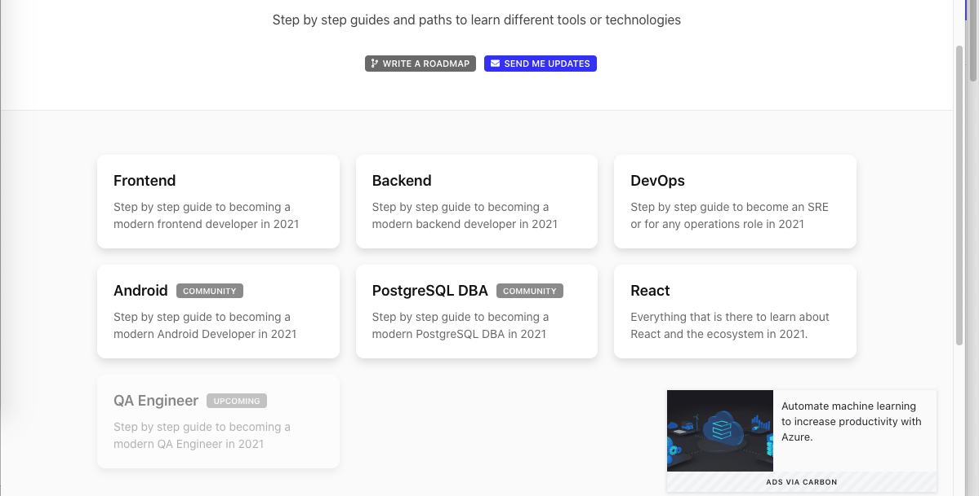
The confuse bud - roadmap.sh

Slide 14
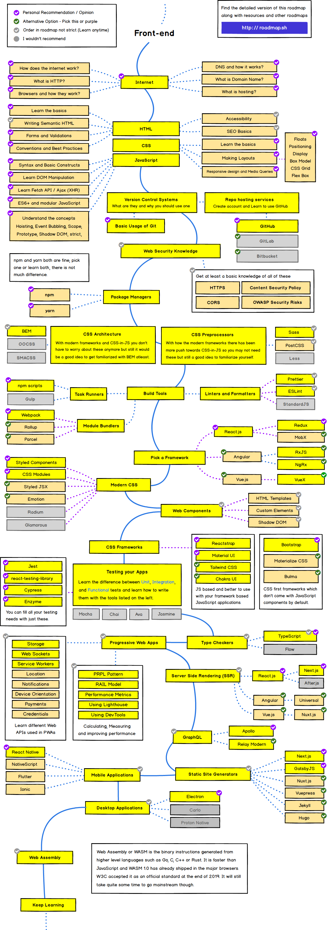

Slide 15
What to begin first?
Front-end
Backend
JS, WASM
SQL’s, non-SQL’s, API, Webservers
Cloud dev
App dev
Cloud servers
Different frameworks

Slide 16
Thanks!
Lets see in the next meet then.
Thankyou for attending and brainstorming your ideas!

Slide 17
Connect with our community
Join discord group

